Slide 1
CrackTree: Automatic Crack Detection from Pavement Images
Authors: Qin Zou, Yu Cao, Qingquan Li, Qingzhou Mao, Song Wang
Austin Derbique 12/07/17

Slide 2
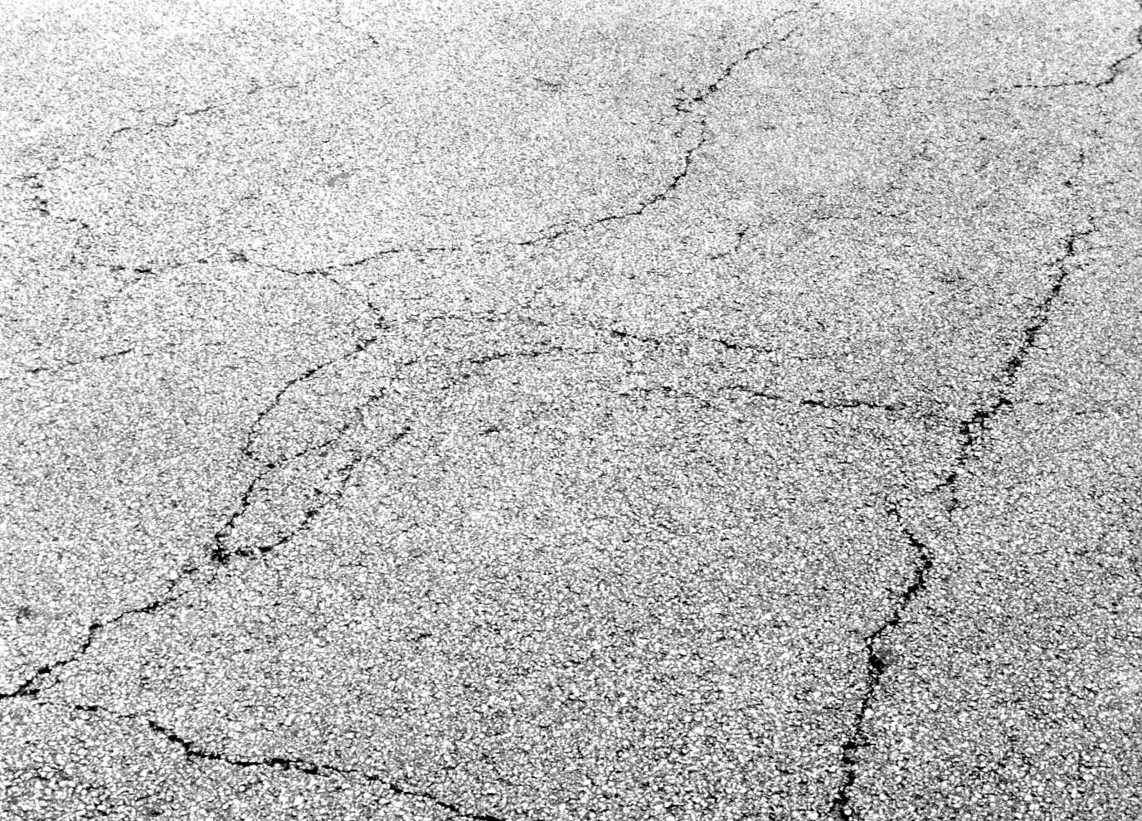
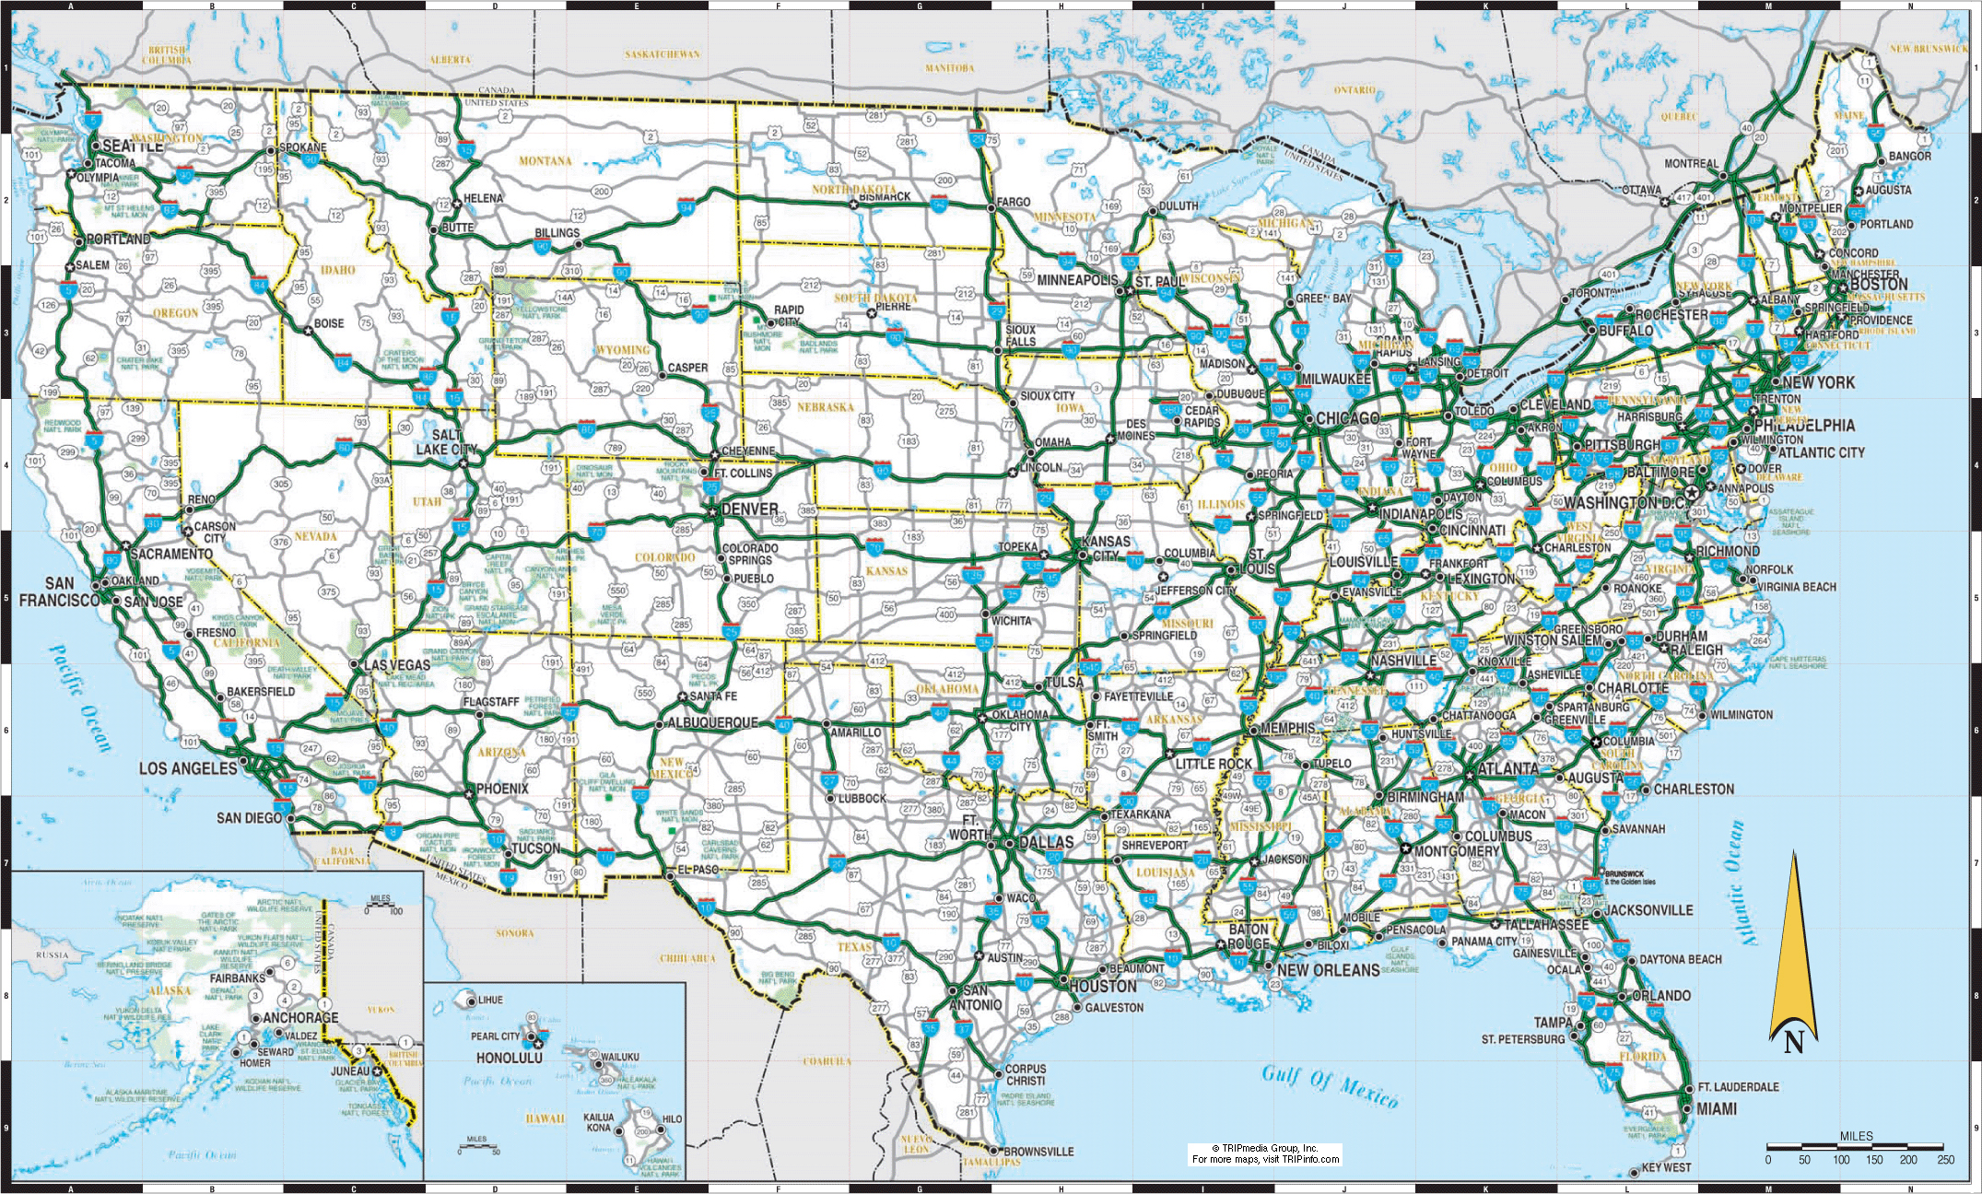
Why care about cracks in pavement?
4.12 million miles of road in the United States (answers.com)
11+ million miles of paved roads in the world (answers.com)
Asphaultinstitute.org 1830ndaytona.info

Slide 3
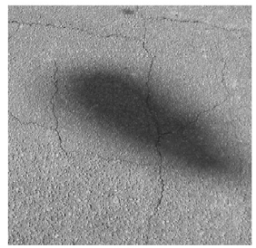
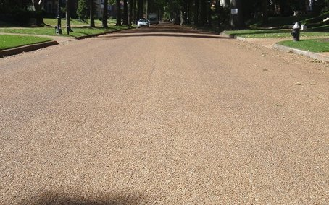
Problems
Low contrast between cracks and surrounding pavement
Changing intensity levels along cracks
Possible shadows with similar intensity to cracks
Cracks with Shadow
Cracks with low contrast levels

Slide 4
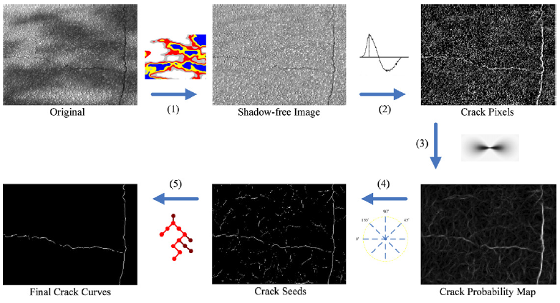
Overview
1. Shadow Removal
2. Local intensity difference analysis
3. Tensor Voting
4. Crack Seed Sampling
5. MST construction and edge pruning

Slide 5
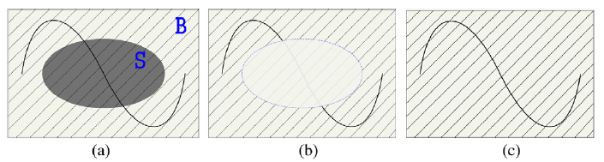
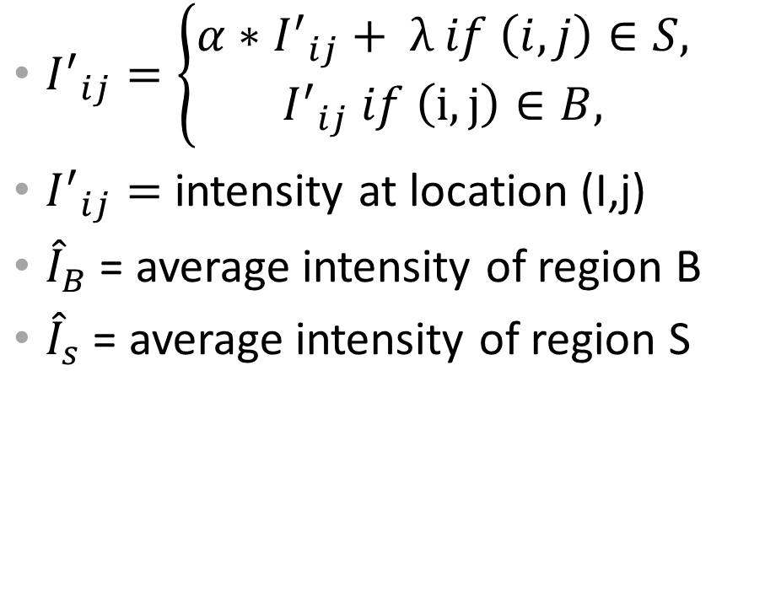
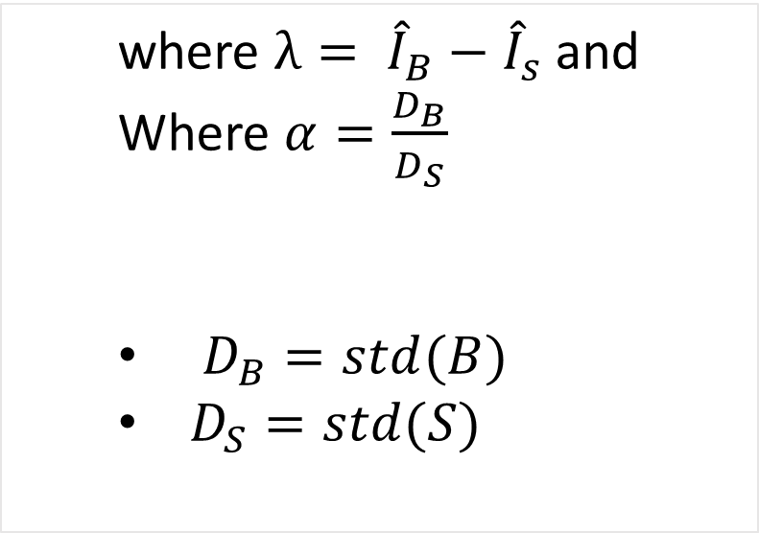
Geodesic Shadow Removal
where $λ= {\hat{I}}_{B}−{\hat{I}}_{s}$ and
Where $α=\frac{D_{B}}{D_{S}}$
$D_{B}=std(B)$
$D_{S}=std(S)$
${I^{′}}_{ij}=\left\{\begin{aligned}{α∗I^{′}}_{ij}+ λ if \left(i,j\right)∈S, \\ {I^{′}}_{ij} if \left(i,j\right)∈B,\end{aligned}\right.$
${I^{′}}_{ij}=$ intensity at location (I,j)
${\hat{I}}_{B}$ = average intensity of region B
${\hat{I}}_{s}$ = average intensity of region S

Slide 6
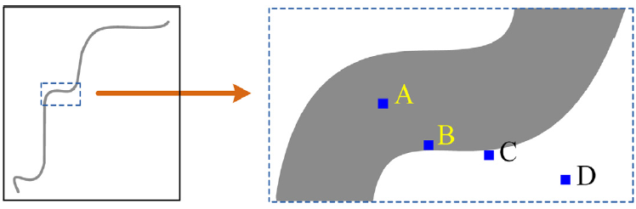
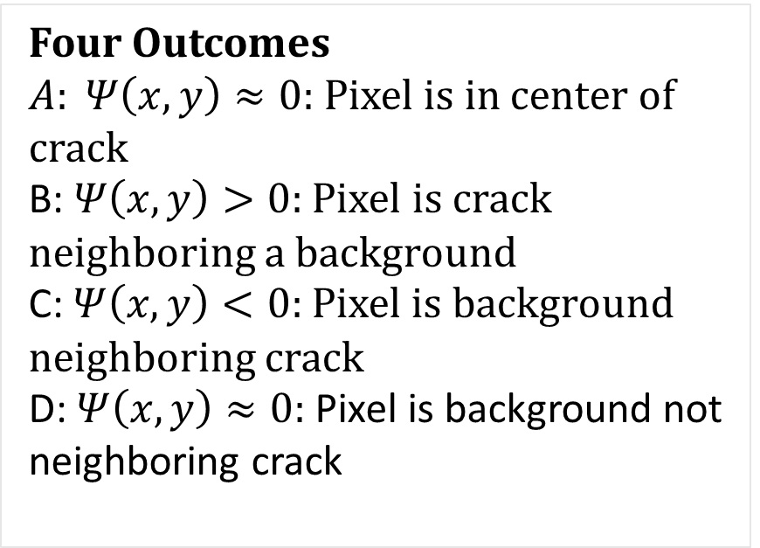
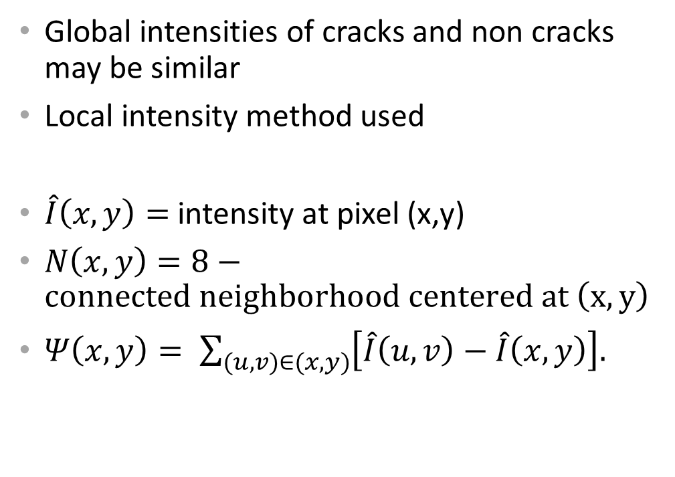
Crack Map Generation – Detecting Crack Pixels
Four Outcomes
$A: Ψ\left(x,y\right)≈0:$ Pixel is in center of crack
B: $Ψ\left(x,y\right)>0:$ Pixel is crack neighboring a background
C: $Ψ\left(x,y\right)<0:$ Pixel is background neighboring crack
D: $Ψ\left(x,y\right)≈0:$ Pixel is background not neighboring crack
Global intensities of cracks and non cracks may be similar
Local intensity method used
$\hat{I}\left(x,y\right)=$intensity at pixel (x,y)
$N\left(x,y\right)=8−connected neighborhood centered at \left(x,y\right)$
$Ψ\left(x,y\right)= \sum_{(u,v)∈(x,y)}{\left[\hat{I}\left(u,v\right)−\hat{I}\left(x,y\right)\right].}$

Slide 7
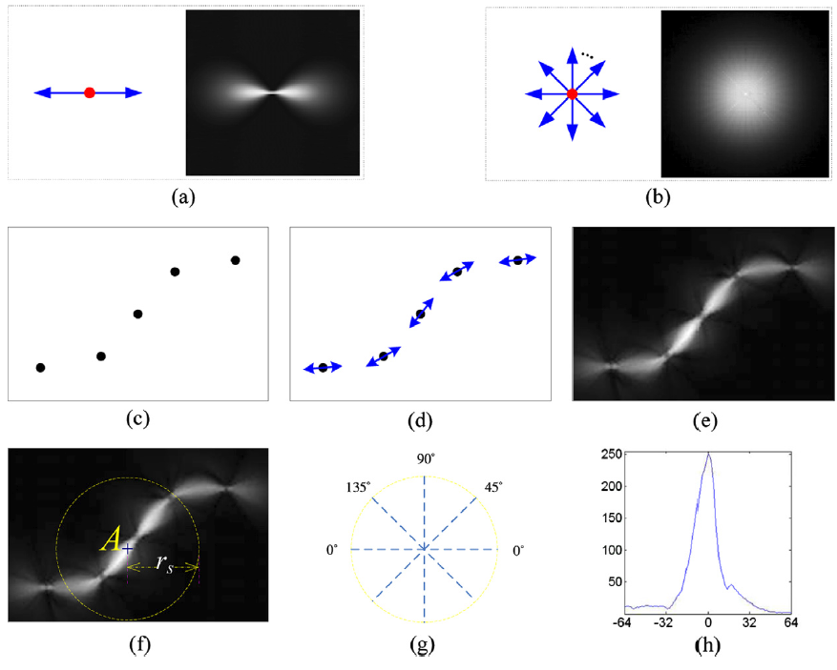
Crack Map Generation - Tensor Voting
Probability of pixels likely to be long curve enhanced
Probability of pixels unlikely to be along curve suppressed
Use standard stick voting. (grouping tokens of similar pixel orientation)
Define Voting Field that encodes proximity and curve continuity
Add up voting fields to achieve crack probability at target location

Slide 8
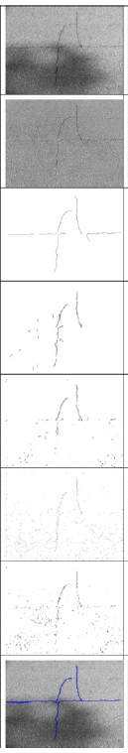
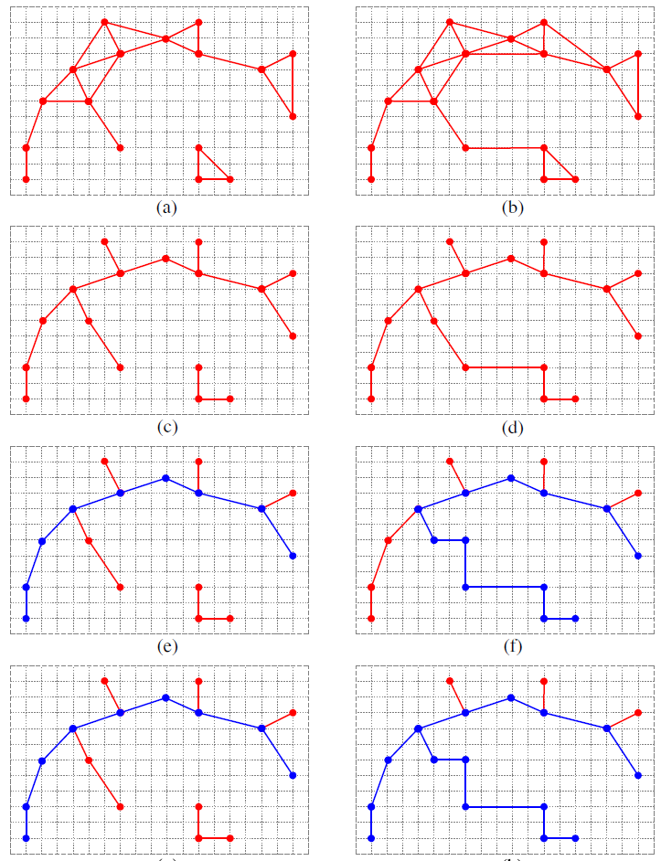
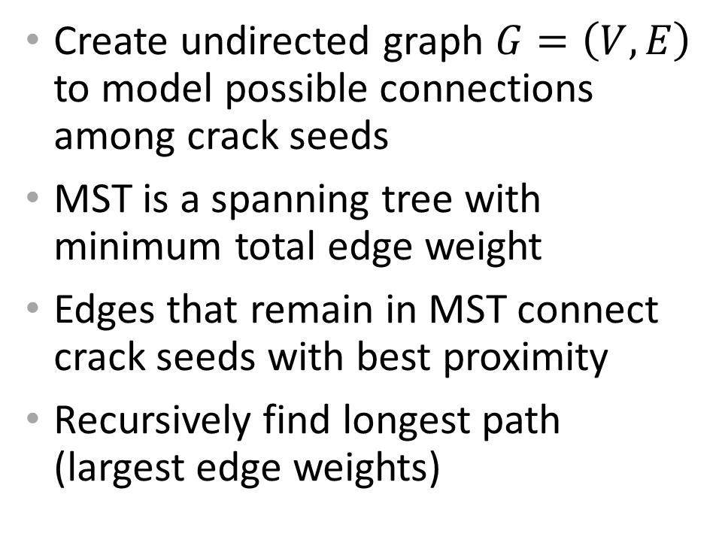
Minimum spanning tree construction and edge pruning
Create undirected graph $G=\left(V,E\right)$ to model possible connections among crack seeds
MST is a spanning tree with minimum total edge weight
Edges that remain in MST connect crack seeds with best proximity
Recursively find longest path (largest edge weights)
Entire Process ->

Slide 9
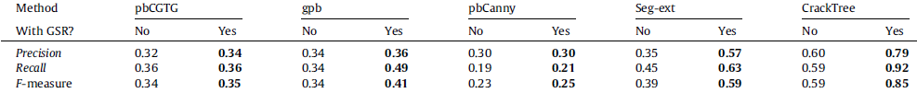
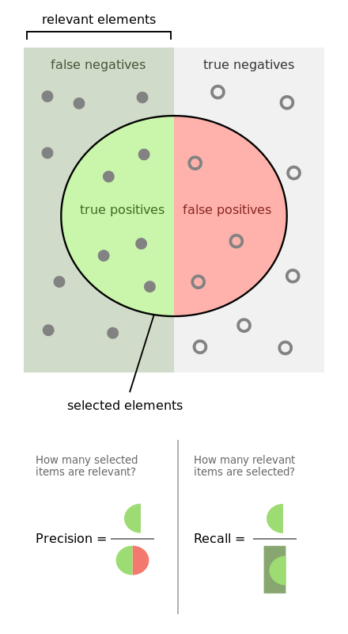
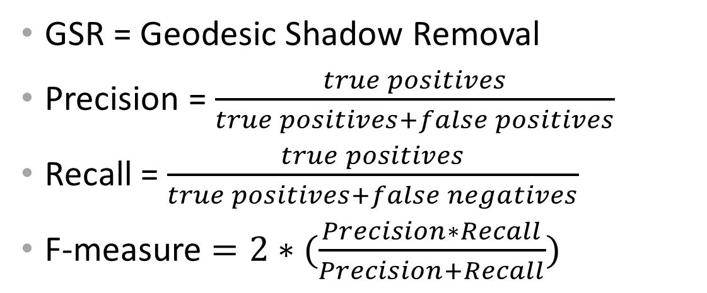
Results
GSR = Geodesic Shadow Removal
Precision = $\frac{true positives}{true positives+false positives}$
Recall = $\frac{true positives}{true positives+false negatives}$
F-measure $=2∗(\frac{Precision∗Recall}{Precision+Recall})$
(wikipedia.org/wiki/Precision_and_recall)

Slide 10
Improvements
Add in support for non-pavement surfaces such as concrete
Ability to sort images based on how much cracking there is

Slide 11
Sources
Paper URL: https://www.sciencedirect.com/science/article/pii/S0167865511003795
Google Images
Wikipedia

